Slide 1
Understanding the association of sleep on inflammation and monocyte phenotype in HIV infection
Priya V. Borker, MD
Mentor: Sanjay R. Patel, MD
Institution: University of Pittsburgh

Slide 2
Objectives
Review the association between poor sleep and increased cardiovascular risk​ ​ ​
Review evidence of monocyte activation in coronary artery disease and sleep deprivation​ ​ ​
Describe a protocol to assess if poor sleep affects monocyte activation in the background of chronic HIV infection

Slide 3
HIV Is an Independent Risk Factor for Cardiovascular Disease
Incidence of Myocardial Infarction
15% of deaths in the US outpatient HOPS study
HIV(+) have 1.5 -2x higher rate than HIV(-)
Higher risk not explained by traditional risk factors or HIV control
(Palella et al., J Acquir Immune Defic Syndr 2006)
(Triant et al, J Clin Endocrinol Metab 2007)
(Freiberg et al, JAMA Intern Med 2013)
Althoff et al., Lancet HIV 2014
Notes:
In the post anti-retroviral therapy era, the life expectancy of PLWH is increasing. With this success, the management of chronic conditions in HIV is becoming increasingly more important.
After excluding AIDS defining illnesses, some epidemiologist estimate that CVD is the 2nd or 3rd leading cause of morbidity and mortality in HIV infected persons.
10-15% of deaths in PLWH are attributable to a cardiac etiology, that is acute myocardial infarction, ischemic stroke or ischemic cardiomyopathy.
Interestingly, HIV+ patients have up to 2x higher rate of ischemic heart disease than their HIV – counterparts.
Michael Freibery’s work in 2013 in the Beterans Agingin Cohort Sutyd demonstrated a 50% increase in acute MI in excess of traditional risk factors.
This study published in Lancet HIV demonstrated similiarly a higher risk of myocardial infarction particularly in the middle-aged. Although part of this excess risk is due to higher prevalence of risk factors, such as hypercholesterolemia, this does not account for the full excess burden. Some studies have demonstrated that there is an increased increase of MI in poorly controlled HIV, however, even in those with controlled HIV, absence of viremia, constituted CD4 counts, we see this excess CVD risk.
And so the question, why is this the case? One proposed mechanism is that chronic systemic inflammation, even despite ART, increases and mediates the risk of CVD in the HIV cohort.

Slide 4
Subjective Poor Sleep Increases Cardiovascular Disease in HIV
Prevalence of sleep disturbance in PLWH up to 58%
Co-morbid insomnia increases risk of CVD amongst patients with HIV
HR 1.62 (95% CI 1.14-2.31)
Limitations: Subjective assessment
%Freedom from CV event
N = 3108
Median follow up: 10.8 years
(Polanka et al, J Acquir Immune Defic Syndr., 2019)
Notes:
Both sleep and HIV are independently associated with increased cardiovascular risk.

Slide 5
Sleep Restriction Induces Inflammatory Monocytes
Baseline
Partial Sleep Deprivation
TNFα and IL-6
5.2
TNFα and IL-6
26.7
Study Protocol:
3 night baseline, 1 night 4 hr sleep restriction
Audience
Monocytes Expressing TNFα
Monocytes Expressing TNFα
IL-6
6.6
IL-6
25.7
Monocytes Expressing IL-6
Monocytes Expressing IL-6
Representative expression of IL-6 and TNFɑ in LPS- stimulated CD14+ cells from a patient
N=30
(Irwin et al., Arch Intern Med 2006)
Notes:
Studies have consistently shown increased systemic inflammatory markers both in SDB and short sleep duration, particularly CRP and IL-6. Several studies have demonstrated increased levels with partial and total sleep restriction.
I wanted to highlight Irwin’s 2006 paper which investigated the effect of acute sleep deprivation on monocytes. These blood collections were done at the same time points per day while awake to minimize circadian effect. This study demonstrated that immediately following a 4hr sleep restriction, the % of monocytes expressing both TNFalpha and IL6 increased from 5.2 → 25%. Furthermore, when the mRNA production of these cytokines were analyzed, the production of TNFalpha increased 2-fold and the production of IL-6 increased 3x fold.

Slide 6
Intermediate monocytes represent a pro-inflammatory subset
Subset | Marker | Function
Classical | CD14++CD16- | Low inflammatory cytokine production
Intermediate | CD14++CD16+ | High production of TNFα, IL-1β, and IL-6
Non-classical | CD14+CD16++ | Patrolling
(Sprangers et al., Journal of Immunology 2016)
(Stansfield and Ingram, Clinical Translational Medicine 2015)
Notes:
Since this study, we have learned more about the monocyte population, that monocytes exist in a heterogenous population best described in 3 parts, classical, intermediate and non-classical.
These monocyte subsets are functionally distinct.
During injury or inflammation, classical monocytes are rapidly recruited to invade the inflamed tissue and contribute to immunological responses, such as recognizing and removing microorganisms and dying cells.
Intermediate monocytes are associated with antigen presentation, high secretion of proinflammatory cytokines and chemokines and wound healing.
Nonclassical monocytes display a patrolling behavior and constantly survey the endothelium as part of the innate local surveillance.
We identify monocytes by their expression of CD14. But we can subdivide them into these subsets by their co-expression of CD16.

Slide 7
Intermediate monocytes predict coronary artery calcium progression in HIV
Monocyte Phenotype at Baseline
CAC measured at baseline and at 2-year follow up
Greater burden of intermediate monocytes in incident and progressive CAC groups
Absent CAC
Incident CAC
Stable CAC
Increased CAC
2%
12%
5.7%
11 %
N= 436
HIV on ART
(Baker et al., AIDS 2014)
Notes:
Although the same prospective studies looking at the incidence of cardiovascular mortality has not been completed in the HIV population, intermediate monocytes have been implicated in HIV-associated atherosclerosis. Similar monocytes compositions have been identified in the HIV population and the CAD population.
Elevated levels of monocyte activation markers are asso with subclinical atherosis in HIV + and HIV – populations (McKibbens 2015.).
In this study by Baker, the burden of intermediate monocytes predict coronary artery calcium progression in HIV. These graphs represent the flow cytometry collected from participants at baseline. CAC were measured at baseline and at 2 year follow up. Figures A and C represent monocyte populations of those who either did not have CAC or those who had stable burden of CAC at the two time points, and as we can see, the proportion of intermediate monocytes is low at 2-6%. In those who either went on to develop CAC, or progress in their CAC burden, this proportion doubled to 12%.

Slide 8
The association of objectively measured poor sleep with inflammation in HIV is unknown The association of chronically poor sleep on monocyte phenotype is unknown
Notes:
Given this background, there are major gaps in the literature on the effect of sleep on cardiovascular disease in the HIV population.
1) The effect of objectively measured poor sleep on cardiovascular disease in HIV is unknown
2) The effect of chronically poor sleep on monocyte phenotype is unknown

Slide 9
Hypotheses
People with HIV with poor sleep (measured objectively) will have measures of increased monocyte activation assessed by:
a: Increased proportion of intermediate monocytes
b: Increased cellular adhesion (“homing”) receptors on monocytes
c: Increased proportion of intracellular inflammatory cytokines
d: Greater monocyte activation markers measured in plasma

Slide 10
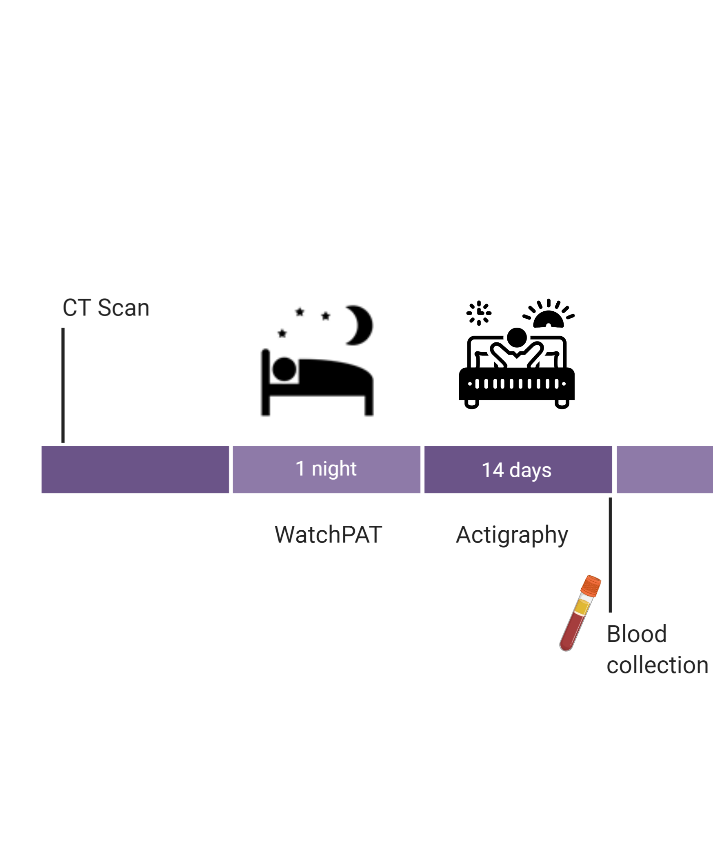
Study Design
Inclusion Criteria:
Age: 18 - 75
HIV +
Virally suppressed
On ART > 48 weeks
CD4 count >200
Sleep Exposures:
AHI4% (WatchPat)
Mean nightly sleep duration
Mean nightly sleep efficiency (Actigraphy)
Notes:
We are currently enrolling HIV + and HIV – patients into our study investigating the associations of sleep on inflammationory markers in HIV
The HIV+ is limited to virally suppressed, well-controlled patients with constituted CD4 count and stable ART for a year
This study relies heavily on the HLRC cohort established by Dr. Morris, as well as some prior studies that these studies have undergone.

Slide 11
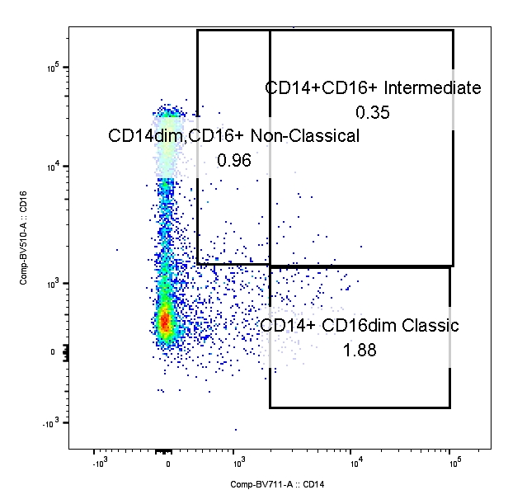
Study Outcome: Monocyte Phenotype
A: Monocyte subsets quantification:
Unstimulated v. LPS v. palmitate
Classical monocyte
Intermediate monocyte
Non-classical
CD16
B: Endothelial Adhesion Expression:
CD18
CCR2
CD11a
CD11b
CD11c
CD14
Notes:
Following 14 days of actigraphy, blood will be collected and analyzed for the population of monocyte subsets both before and after stimulation with LPS. The LPS stimulation is important, because one of the underlying causes of chronic inflammation proposed in this cohort is microbial translocation. For example, Jason Breverly.
Therefore, this LPS stimulation is our attempt to mirror this physiologic phenomenon.
PBMCs will be isolated and cryopreserved. They will undergo 4 hours stimulation with LPS and brefeldin to prevent cytokine secretion. CD16 and CD14 expression will be assess for monocyte susbstes.

Slide 12
Study Outcome: Monocyte Activation
Intermediate monocyte (CD14++CD16+)
C: Monocyte Intracellular Staining
CD14
TNFalpha
IL-6
IL-1b
IL-1B
Monocyte Cytokine Secretion (ELISA)
Sample 1
Sample 2

Slide 13
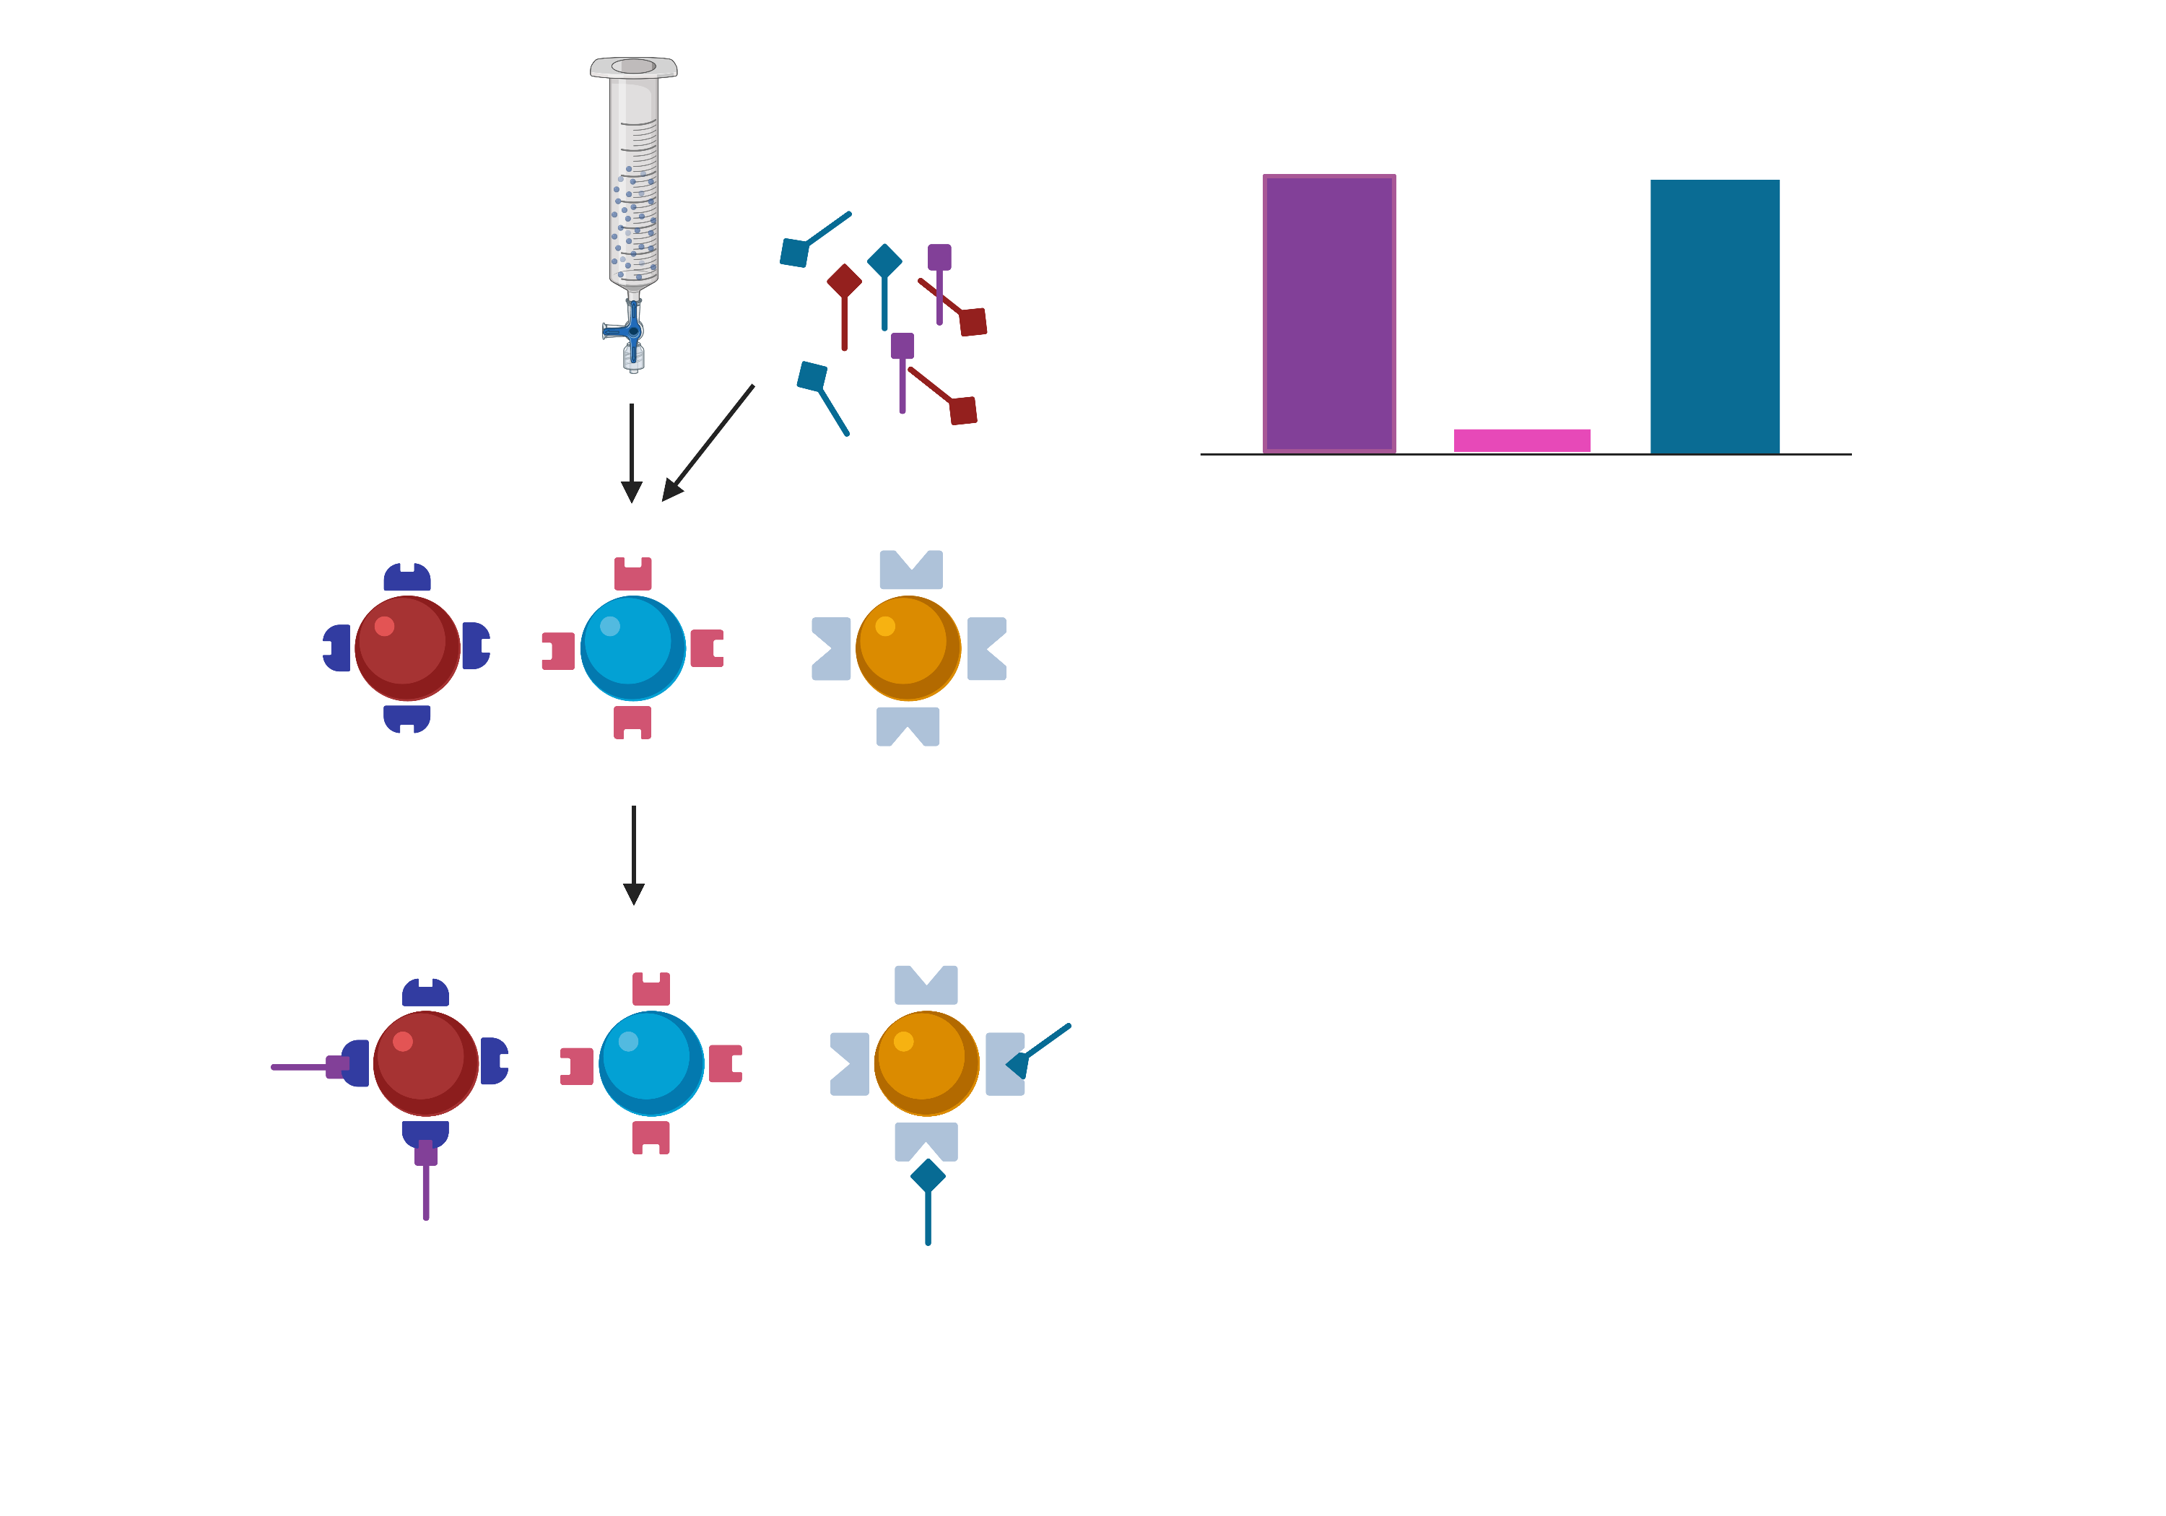
Study Outcome: Systemic Inflammation
D: Serum Measurements:
Luminex Assay
Assessing 11 markers:
sCD163
sCD14
Granzyme B
IL-6
IL-10
CXCL10
TNFalpha
TNFR1
TNFRII
CRP
Endothelin
Protein 1
Protein 2
Protein 3
Schema of Luminex Assay
Notes:
Outcome: Monocyte subset
Switch out picture for dim monocyte population

Slide 14
Progress Thus Far
Characteristic | HIV + (n=52)
Age | 59.4 ± 8.0
Gender
Male | 42 (81%)
Female | 10 (19%)
Race
White | 23 (44%)
Black | 26 (50%)
Other | 3 (6%)
CD4 count | 664 ± 305
Sleep Characteristic | Total n | Median (IQR)
AHI (events/hr) | 49 | 6.4 (3.5,13.2)
Sleep Duration (hr) | 26 | 6.7 (5.64, 7.80)
Sleep Efficiency | 26 | 87% (82%-92%)
Target: 150 HIV +
Notes:
Total 58 participants recruited

Slide 15
AHI N = 37
Actigraph = 19
Results: Plasma Soluble Markers
AHI
Sleep duration
Sleep Efficiency
sCD163
sCD14
TNFalpha
sTNFRI
sTNFRII
IL-6
IL-10
IFN-gamma
Granzyme B
CXCL10
CRP
p-value 0.029
sCD163
sCD14
TNFalpha
sTNFRI
sTNFRII
IL-6
IL-10
IFN-gamma
Granzyme B
CXCL10
CRP
sCD163
sCD14
TNFalpha
sTNFRI
sTNFRII
IL-6
IL-10
IFN-gamma
Granzyme B
CXCL10
CRP
p-value 0.022
p-value 0.045
p-value 0.039
Analysis with Spearman r correlations
Notes:
Outcome: Monocyte subset
Switch out picture for dim monocyte population

Slide 16
Results: sCD163
N=36
N=19
Notes:
Outcome: Monocyte subset
Switch out picture for dim monocyte population

Slide 17
Results: sCD14
N=37
N=19
Notes:
Outcome: Monocyte subset
Switch out picture for dim monocyte population

Slide 18
Results: TNFalpha (plasma)
N=19
N=19
Notes:
Outcome: Monocyte subset
Switch out picture for dim monocyte population

Slide 19
Future Directions
Association of poor sleep health and subclinical cardiovascular disease
Inflammatory markers in other dimensions of sleep health (eg: insomnia, regularity, circadian mismatch)
Assessing poor sleep health and inflammation in HIV(-) population
Assessing poor sleep health and lymphocytes in HIV(+)
Assessing poor sleep health and inflammatory markers following acute sleep restriction

Slide 20
Timeline
Run Luminex assays
Career Goal:
Translational research in sleep and immunology
2021 Goals:
Generate preliminary data
Improve expertise in immunology
Publish in immunology
2022 Goals:
Submit K award June 2022
Optimize monocyte assays
Run monocyte assays
June/July
August
September - December
Submit 1st author manuscript (CHEST)
Submit F32 NRSA grant
Submit 1st author Methods paper (OFID)
Submit 2nd^{st} author review paper (OFID)
Submit 1st author manuscript (SLEEP)
Submit abstracts:
ATS
APSS
CROI
Submit 2nd author review manuscript (OFID)
Notes:
Progress Thus Far

Slide 21
Scholarly Activities
Education
ABIM Sleep Certified
ASPIRE Webinars monthly
Sleep T32 weekly conferences
Sleep and Circadian Workshop on Indispensable Methods
Advanced Immunology Course
Manuscripts:
1. Scammell TE, Luo G, Borker P, Sullivan L, Biddle K, Mignot E. Treatment of narcolepsy with natalizumab. Sleep. 2020 Apr 6; PubMed PMID: 32249922
2. Borker PV, Valesky M, Phalunas C, Wyland Clayton, Nouraie SM, Patel SR. Patient preferences on Initiating Treatment with Positive Airway Pressure (manuscript submitted to SLEEP)
3. Borker PV, Reid M, Softer T, Butler MP, Azarbarzin A, Wang H, Wellman A, Sands SA, Redline S. NREM Apnea and Hypopnea Duration: Variation Across Population Groups and Physiological Correlates (manuscript submitted to AJRCCM)
4. Borker PV, Carmona E, Saeed G, Nouraie SM, Bakker JP, Stitt CJ, Aloia MS, Patel SR. Lower CPAP Adherence in Minority Neighborhoods (manuscript in preparation)
5. Helms E, Borker PV, Macatangay B. Adenosine and HIV Review (manuscript in preparation)
Other Projects
Effect of acute sleep deprivation on monocyte activation in PLWH
Association of sleep duration and lymphocyte count in the Multicenter AIDS Cohort Study
Monocyte phenotype in COVID infection

Slide 22
Acknowledgements
Patel Lab
Macatangay Lab
Alison Morris
Jessica Bon
Seyed Mehdi Nouraie
Divay Chandra
Rebecca DeSensi
Keven Robinson
Martica Hall
Christopher O’Donnell
Faraaz Shah
APDs
PACCM Division
ASPIRE Fellowship
T32 Sleep Research Fellowship
Shirley Longinotti
Caitlin Phalunas
Guljana Saeed
Grace Vincent
Steven Swanger
Clayton Wyland
Emely Carmona
Cynthia Klamar-Blain
Lori Caruso
Benjamin Morris
Funding Sources
Mentors:
Sanjay Patel (primary)
Bernard Macatangay
Daniel Buysse
American Thoracic Society Academic Sleep Pulmonary Integrated Research/Clinical (ASPIRE) Fellowship; HL127307, HL142118
Notes:
Acknowledgements

